Slide 1
Dev Ops
2025
Poornima

Slide 2
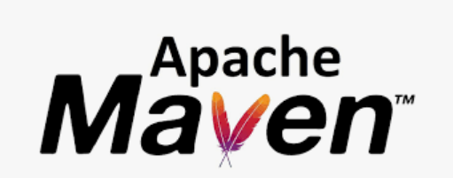
Maven
Maven is a build automation and project management tool developed using the Java programming language.
It helps manage:
Dependencies (libraries your project needs).
Builds (compiling, packaging, testing).
Project structure and documentation.
Maven utilizes the Project Object Model (POM), where the pom.xml file describes the project’s configuration and dependency management.
The pom.xml file is the heart of Maven. It defines:
Project details (name, version).
Dependencies (external libraries).
Plugins (tools to extend Maven’s functionality).
Build configurations.

Slide 3
Maven - Default (or Build) Lifecycle:
Validate: Ensures the project is correctly configured and all necessary information is available.
Compile: Compiles the source code of the project.
Test: Executes unit tests using a testing framework like JUnit.
Package: Bundles the compiled code into a distributable format, such as a JAR or WAR file.
Verify: Runs checks to ensure the package meets quality standards.
Install: Installs the package into the local repository for use as a dependency in other projects.
Deploy: Copies the package to a remote repository for sharing with other developers

Slide 4
Maven - Execution:
Through the command prompt:
Install maven OS level from the path https://maven.apache.org/download.cgi
C:\Program Files\apache-maven-3.9.6\bin
** configure the maven path in environment variable.
open command prompt --> mvn –version
Execution -
cd <<Pom.XML path>
mvn test
<<Add these 2 lines to run.bat file>>
Through pom.xml
dependencies --- download required dependency jar for project
plugins ---> to compile and run the project
maven compiler plugin
maven surefire plugin
Add the testNG XML and Right click and Run as Maven Test

Slide 5
Maven - Commands:
mvn clean:
Cleans the project by removing the target directory and all its contents, effectively deleting previously built artifacts.
mvn validate:
Validates the project's pom.xml and ensures all necessary information is available and correct.
mvn compile:
Compiles the source code of the project and places the compiled classes in the target/classes directory.
mvn test:
Runs the unit tests of the project using a suitable testing framework (e.g., JUnit).
mvn package:
Compiles the code, runs tests, and packages the compiled code into a distributable format (e.g., JAR, WAR, or EAR) in the target directory.
mvn verify:
Runs any checks to verify the package is valid and meets quality criteria after packaging.
mvn install:
Installs the packaged artifact into the local Maven repository, making it available for other local projects to use as a dependency .

Slide 6
Maven – Commands:
.mvn deploy:
Deploys the packaged artifact to a remote repository, making it accessible to other developers and projects in a shared environment.
mvn site:
Generates a project website and documentation.
mvn archetype:generate:
Generates a new project from a Maven archetype, which is a project template.
mvn dependency:tree:
Displays the project's dependency tree, including transitive dependencies, which is useful for debugging dependency conflicts.
mvn help:effective-pom:
Displays the effective pom.xml after considering inheritance from parent POMs and the Maven Super POM.

Slide 7
Maven – Commands:
Combining Commands:
Commands can often be combined to execute multiple phases sequentially, for example:
mvn clean install:
Cleans the project and then installs the packaged artifact into the local repository.
mvn clean deploy:
Cleans the project and then deploys the packaged artifact to a remote repository.

Slide 8
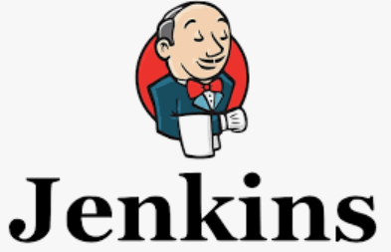
Jenkins
Jenkins is an open-source automation server widely used for enabling Continuous Integration (CI) and Continuous Delivery (CD) in software development, including the automation of testing.
Core Components and Stages:
Continuous Integration
Continuous Delivery/Continuous Deployment
https://www.jenkins.io/

Slide 9
Jenkins – CI Integration
Source Code Management (SCM) Integration: Jenkins monitors a version control system (e.g., Git) for new code commits.
Build: When changes are detected, Jenkins automatically builds the application, compiling code and resolving dependencies.
Automated Testing: Unit tests, integration tests, and other automated tests are executed to ensure code quality and identify issues early.

Slide 10
Jenkins – Continuous Delivery (CD) / Continuous Deployment (CD):
Packaging: The built application is packaged into deployable artifacts (e.g., JAR, WAR, Docker image).
Deployment to Environments: The packaged application is deployed to various environments, such as development, staging, and production.
Continuous Delivery: Automates the process up to the point of deployment, requiring manual approval for production deployments.
Continuous Deployment: Automates the entire process, including deployment to production, without manual intervention.

Slide 11
Jenkins – Key Features and benefits
Automation: Automates repetitive tasks, reducing manual effort and human error.
Faster Feedback: Provides rapid feedback on code changes, enabling quick identification and resolution of issues.
Improved Code Quality: Enforces automated testing and integration, leading to higher-quality software.
Faster Release Cycles: Accelerates the delivery of new features and bug fixes to users.
Traceability: Provides a clear audit trail of changes and deployments.
Flexibility: Highly customizable through a rich ecosystem of plugins to integrate with various tools and technologies.
Jenkinsfile: Pipelines can be defined as code using a Jenkinsfile, allowing for version control and reusability.

Slide 12
Jenkins – How it works?
A Jenkins pipeline is typically defined using a Jenkinsfile, a Groovy script that specifies the stages and steps of the pipeline. When a change is committed to the SCM, Jenkins triggers the pipeline, which then executes the defined stages sequentially, moving the code through the build, test, and deployment phases.

Slide 13
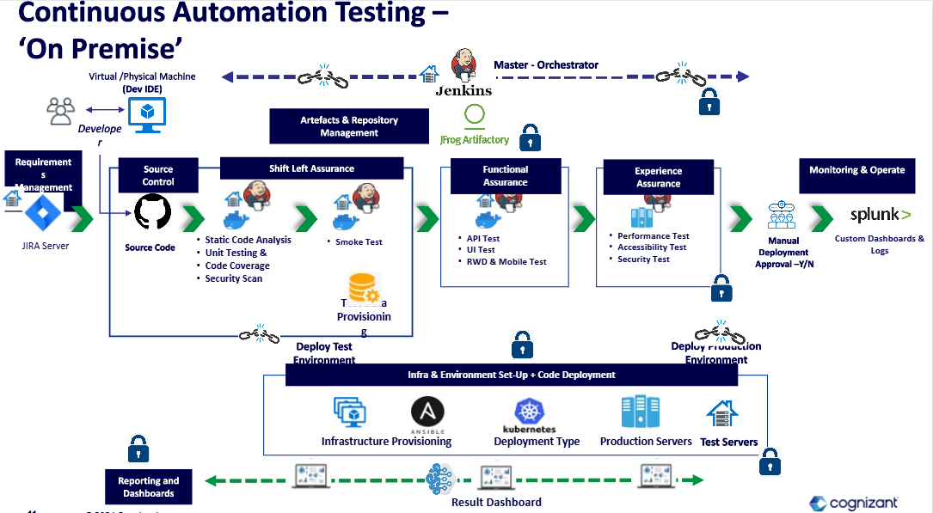
Jenkins – How it works?

Slide 14
Jenkins – How it works?
Groovy scripts play a significant role in Jenkins, particularly in the context of creating and managing Jenkins Pipelines. Groovy is a dynamic language for the Java platform, and its syntax is similar to Java, making it accessible to Java developers.

Slide 15
Jenkins – How it works?
pipeline { ... }: The root block for the entire pipeline.
agent { ... }: Specifies where the pipeline or a specific stage will run (e.g., agent any, agent { node { label 'my-agent' } }).
stages { ... }: Contains one or more stage blocks.
stage('Stage Name') { ... }: Defines a single stage in the pipeline.
steps { ... }: Contains the individual actions to be performed within a stage (e.g., sh 'mvn clean install', echo 'Hello World').
post { ... }: Defines actions to run after a stage or the entire pipeline completes, based on status (e.g., always, success, failure).
options { ... }, parameters { ... }, triggers { ... }, environment { ... }, input { ... }: Other optional blocks for configuring pipeline behavior.

Slide 16
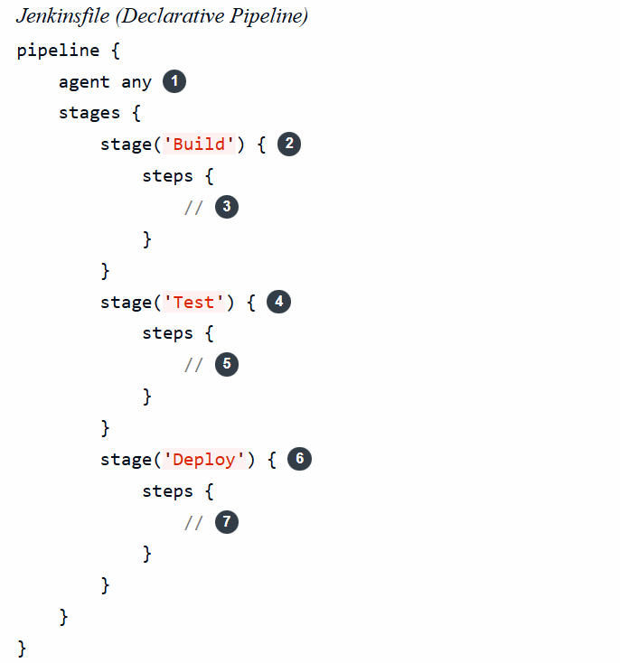
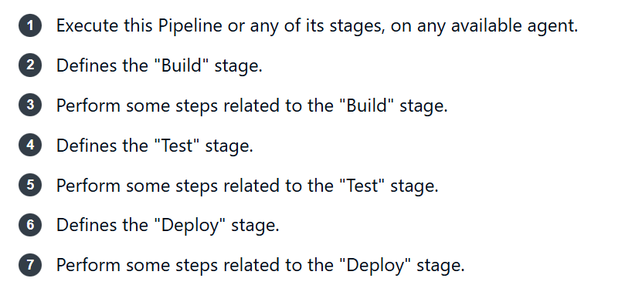
Jenkins – How it works?

